Slide 1
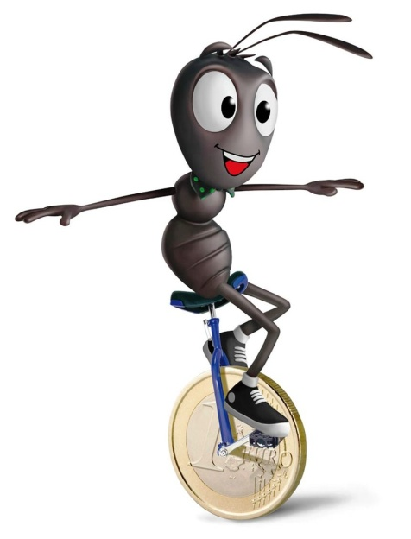
FINANCIAL EDUCATION AND
THE GENDER GAP
Giovanna Paladino
Director Museo del Risparmio
IFFM co-Chair
5th IFFM ANNUAL MEETING
Financial Education Summit, Erste Financial Life Park -
Vienna 5th - 6th October 2017

Slide 2
Agenda
5th IFFM ANNUAL MEETING
Stylized facts
How women manage money: a new survey
What to do…what we did

Slide 3
Stylized facts
5th IFFM ANNUAL MEETING
People make financial decisions with long term consequences. We decide whether to save, how to invest our wealth, whether to take on a debt and of what kind, whether to buy an insurance and to what kind of pension fund we should subscribe.

Slide 4
Stylized facts
5th IFFM ANNUAL MEETING
A gender gap in the financial literacy of women compared to men has been reported in several studies (Lusardi and Mitchell, 2014, Bucher-Koenen et al. 2014 among others).
Recently Klapper et al. (2015) based on the S&P’s Gallup survey on financial literacy confirm that the degree of financial literacy is indeed higher for men in 135 out of the 144 countries participating in the survey.

Slide 5
Stylized facts
5th IFFM ANNUAL MEETING
The Allianz 2017 survey revealed that the gender gap exists in all the 10 European countries considered and it is much higher in the case of risk-related questions than in the case of the basic financial literacy questions.
Across all countries, the average number of right answers of men is 14% higher than those for women on the two financial literacy questions, while it is 31% higher for the three risk-related questions.
OECD PISA 2015 survey on financial literacy found that in most countries there are no differences in financial literacy between boys and girls at the mean but in 9 countries out of 15 more boys than girl are low performers.
The gender gap is closing EXCEPT in Italy.
Notes:
La peggiore per gender gap in risk adversion è il belgio ma in generale il gender gap più ampio è in italia

Slide 6
Stylized facts
5th IFFM ANNUAL MEETING
Reasons explaining
the GENDER GAP:
Self-esteem: when not absolutely certain women prefer to choose the answer “I do not know”;
Lower maths skills: for a number of cultural reasons women’s attitude towards STEM is less positive.
Divergence in income, education, financial responsibility and social inclusion
Language matters: women may simply not be interested or involved by the neutral language used in standard surveys.
Notes:
La peggiore per gender gap in risk adversion è il belgio ma in generale il gender gap più ampio è in italia

Slide 7
How women manage money
5th IFFM ANNUAL MEETING
Italian women are less financially literate than Italian men and than women in other countries. A fact that is confirmed after checking for a large set of control variables.
Given that they admit to knowing little or not enough about money, we dug deeper to understand
How women manage money
How they make financial decisions.
MoS has designed a very wide-reaching survey to collect information about money management from 1000 people, of which 750 were women. The sample has been appropriately stratified to account for social, geographical and demographic factors.

Slide 8
How women manage money
5th IFFM ANNUAL MEETING
Some facts:
50% of women declare they earn less than their partners (vs 9% of men).
21% of women (vs 8.7% of men) do not have a personal current account, 9% have no current account at all (vs 5% of men).
17% of women with a private income do not have a personal current account.
12% of women with a personal account do not manage their current account on their own.

Slide 9
How women manage money
5th IFFM ANNUAL MEETING
Main Results: Perception of Independence
subsample of women living with a partner
Notes:
455

Slide 10
How women manage money
5th IFFM ANNUAL MEETING
Main Results: Perception of Independence
41% of the women declare that they manage the family budget.
BUT they are mainly in charge of daily expenses not of financial decisions.
% VALUES – I decide | Tot. MEN | Tot. MEN FAMILY BUDGET MANAGER | Tot . WOMEN | Tot. WOMEN FAMILY BUDGET MANAGER
Day-to-day expenses | 40.4 | 38.1 (-2.3) | 64.2 | 78.5 (+14.3)
Expenses to be cut | 45.0 | 50.4 (+5.4) | 44.7 | 59.7 (+15.0)
Budgeting | 55.2 | 76.0 (+20.8) | 37.6 | 46.4 (+8.8)
Major and extraordinary spending | 44.9 | 56.3 (+11.4) | 34.9 | 38.6 (+3.7)

Slide 11
How women manage money
5th IFFM ANNUAL MEETING
Main Results: accidental savers
68.8% (71.2% of men) of women declare that they save part of their income
19.4% are intentional savers (vs 23% of men)
49.4% are accidental savers (vs 48.4% of men)

Slide 12
How women manage money
5th IFFM ANNUAL MEETING
Main Results: Saving is?

Slide 13
How women manage money
5th IFFM ANNUAL MEETING
Main Results: How women DO NOT INVEST their saving
Tot. investors:
Men: 66.0%
Women: 45.9%

Slide 14
How women manage money
5th IFFM ANNUAL MEETING
Main Results: How women DO NOT INVEST their saving
Sub sample of not investors

Slide 15
How women manage money
5th IFFM ANNUAL MEETING
Main Results: How women INVEST their saving
 | M | W | 25-44 graduate
In government bonds (BOT, CTT, CTP) and post office savings | 33.0 | 28.3 | 37.6
In a pension fund | 28.8 | 25.6 | 29.7
In bonds | 27.3 | 30.6 | 28.9
In a mutual fund | 27.1 | 23.1 | 28.7
In shares | 26.4 | 18.7 | 25.7
In insurance products | 27.1 | 24.7 | 26.6
In valuables (gold/jewels/currency/art) | 12.1 | 10.8 | 9.8
In property (garage, apartments, land) | 11.9 | 6.0 | 6.8

Slide 16
How women manage money
5th IFFM ANNUAL MEETING
Main Results: Financial literacy self assessment
Men: 68.1
Women: 50.1

Slide 17
How women manage money
5th IFFM ANNUAL MEETING
Main Results: Financial literacy matters for investments decisions
Do you invest your savings? | W | Very / Quite updated on financial matters | Little / In no way updated on financial matters
Yes, a large part | 17.0 | 24.8 | 8.4
Yes, but only a little | 28.9 | 33.9 | 23.5
No, i do not invest | 54.1 | 41.3 | 68.1
TOTAL INVESTORS | 45.9 | 58.7 | 31.9

Slide 18
How women manage money
5th IFFM ANNUAL MEETING
Main Results: Financial literacy matters for investments decisions
women
How do you invest your money? | Very / Quite updated on financial matters | Little / In no way updated on financial matters
In bonds | 33.8 | 24.1
In government bonds (BOT, CTT, CTP) and post office savings | 30.0 | 24.8
In a mutual fund | 27.5 | 14.3
In a pension fund | 26.8 | 23.2
In insurance products | 24.8 | 24.3
In shares | 22.1 | 11.8
In valuables (gold/jewels/currency/art) | 10.4 | 11.6
In property (garage, apartments, land) | 6.2 | 5.6

Slide 19
How women manage money
5th IFFM ANNUAL MEETING
Main Results: How to involve women in training activities

Slide 20
How women manage money
5th IFFM ANNUAL MEETING
Main Results: How to involve women in training activities
 | M | W | 25-44 graduate
Yes, using Internet (web seminars, on-line platforms, etc.) | 44.5 | 34.2 | 46.3
Yes, using printed or digital material like manuals and/or guides | 33.1 | 34.2 | 33.6
Yes, through actual courses, conferences and seminars | 20.2 | 16.9 | 25.7
No, not interested | 26.1 | 34.8 | 21.0
Notes:
Donne laureate 24-44 241

Slide 21
How women manage money
5th IFFM ANNUAL MEETING
Main results: Gender transmission of financial knowledge
Relatives are key in passing on the art of money management
Women learn from women and men from men

Slide 22
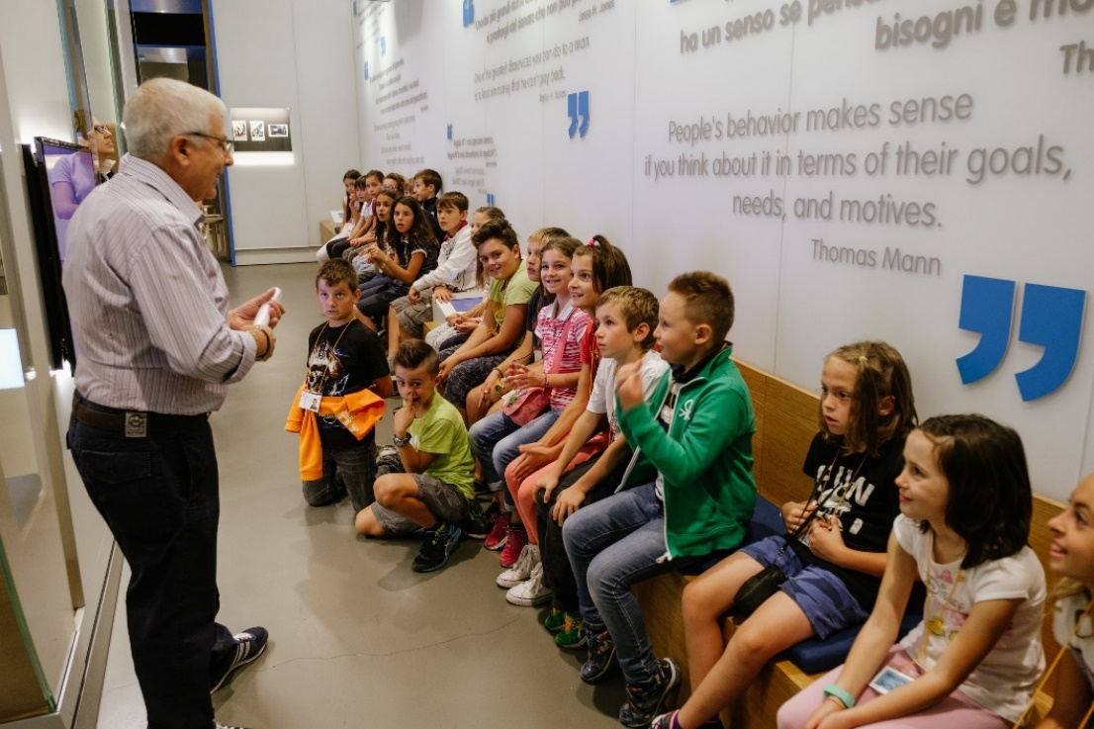
What to do…what we did
5th IFFM ANNUAL MEETING
Start with kids as the gender gap is significant at early ages
Lab for kids ( “It’s up to you”)
Use “girl friendly” language and contexts
Give allowances to be managed autonomously (the right amount)

Slide 23
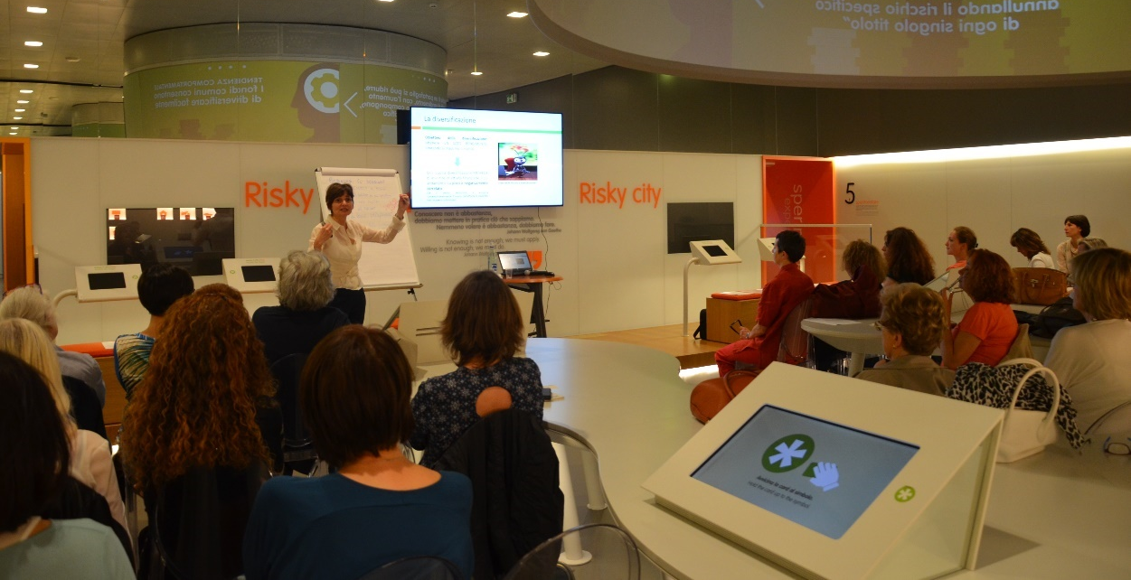
What to do…what we did
5th IFFM ANNUAL MEETING
Involve adult women
Get them involved using personal examples
Convince them to reverse priorities once in a while; family is important but so is training
Vary the schedule of sessions across the day so that they can find the right slot

Slide 24
What to do…what we did
5th IFFM ANNUAL MEETING
Work with adult women
Organize workshops specific to their needs (risk, budgeting, planning)
Organize workshops with mums and children during the week-end
Prepare booklets, videos and other materials to provide distance learning
Exploit the craving for knowledge of young graduate women (24-44), involving them in on-site activities
Finally
Hope this will work
OPTIMISM increases the chance of hitting the target

